Slide 1



CyberMind AI
SOCCA - MSC DS
PROJECT REVIEW – IV
AI-Powered Cyber Intelligence Platform
Under the Guidance of:
Ms. Ritika Savaliya
SOCCA – Silver Oak University | M.Sc. Data Science
Ms. Ritika Savaliya
SOCCA – Silver Oak University | M.Sc. Data Science
Presented by Daksh Vasani
ER. NO: 2504070500037

Slide 2
Project Overview & Final Status
CyberMind AI is an enterprise-grade Cyber Threat Intelligence (CTI) and Malware Analysis Platform consolidating multi-vector security telemetry into a unified single pane of glass. It bridges rule-based heuristics, 4 supervised Random Forest classifiers (96.67% accuracy), and Groq Llama-3 70B AI explanations to produce a standardized 0–100 cyber risk score and automated executive mitigation reports.
01 | 10 Specialized Scanners
02 | 13 External APIs & 30+ Services
03 | Machine Learning (96.7% Acc)
04 | Generative AI & Reports
MODULAR MULTI-VECTOR ENGINES
• Full-spectrum threat surface coverage across Web, Network, Files, and Endpoints.
• Dedicated modules for URL, Website, Domain, Email, IP, Phone, File/PE, and QR.
• Universal Auto-Scanner with intelligent regex input inference & automated dispatch.
AGGREGATED THREAT FEEDS
• Real-time enrichment via 13 APIs: VirusTotal, AbuseIPDB, Google Safe Browsing, Groq, Veriphone, Numverify, Abstract, IPinfo, IPQS, VerificarEmails.
• Deep IP geolocation, ASN lookup, and commercial proxy / Tor exit node detection.
• Strict 5s async timeouts with resilient local deterministic heuristic fallbacks.
SUPERVISED THREAT CLASSIFIERS
• 4 Scikit-Learn Random Forest models trained on 242,341 verified security samples.
• 50 lexical and structural URL features extracted in real time (<18.5ms latency).
• PE header anomaly detection, section entropy, and hex signature analysis.
GROQ LLAMA-3 70B SYNTHESIS
• Translates complex JSON telemetry into concise 3-sentence executive summaries (<1.2s).
• Tailored defensive recommendations for both SOC analysts and executive leaders.
• Automated branded PDF & JSON security report generation with MITRE ATT&CK mapping.
2
CyberMind-AI

Slide 3
Final System Architecture
DECOUPLED 3-TIER ENTERPRISE ARCHITECTURE & END-TO-END PROCESSING PIPELINE
STEP 1
STEP 2
STEP 3
STEP 4
STEP 5
STEP 6
Target Input
Analyst submits URL, Domain, IP, Email, Phone, File, or QR code via Streamlit / API.
Validation
core/validator.py executes schema sanitization, regex matching, and boundary checks.
Scanner Engine
modules/scanner_engine.py routes target; executes 30+ services across 13 TI APIs concurrently.
ML Inference
4 Random Forest models extract 50 features and calculate class probabilities in <18.5ms.
Risk Engine
Weighted fusion: Score = 0.45*API + 0.35*ML + 0.20*Heuristics with critical overrides.
AI & Reports
Groq Llama-3 70B synthesizes executive diagnosis; logged to cybermind.db & exported to PDF.
✔ Decoupled 3-Tier Layering
Presentation (Streamlit), Application (Services/Modules/ML), and Storage (SQLite) are strictly isolated for zero coupling, modular testability, and enterprise maintainability.
✔ Provider-Agnostic Services
All 13 external APIs are accessed via modular service wrappers in services/, ensuring core security algorithms remain completely independent of external vendor changes.
✔ Zero-Downtime Offline Fallbacks
Every external connector implements graceful local heuristic fallbacks with strict 5-second asynchronous timeouts, guaranteeing 100% platform availability offline.
3
CyberMind-AI

Slide 4
Final Module Implementation
VERIFIED STATUS OF ALL 10 CYBER THREAT INTELLIGENCE SCANNERS (100% PASS RATE)
Scanner Module | Target Vector | Key Capabilities & Core Demonstrable Features | Implementation Status
1. URL Scanner | URLs & Web Links | 50 lexical features, Shannon entropy, redirect tracing, Google Safe Browsing / VirusTotal | Verified Pass ✔
2. Website Scanner | Web Applications | SSL/TLS cert chain audit, cipher security, security headers (CSP/HSTS), tech stack fingerprinting | Verified Pass ✔
3. Domain Scanner | Domains & DNS | WHOIS registry audit, creation/expiration dates, DNS A/MX/NS resolution, DNSSEC validation | Verified Pass ✔
4. Email Scanner | Email Deliverability | MX host resolution, SPF/DKIM/DMARC records audit, disposable burner domain blocklist | Verified Pass ✔
5. IP Scanner | IP Addresses & ASNs | AbuseIPDB reputation (0-100%), IPinfo geo-coordinates, ASN lookup, Tor exit node detection | Verified Pass ✔
6. Phone Threat Intel | Telephony Vectors | International E.164 parsing, Veriphone carrier identification, line type (VoIP/Mobile/Landline) | Verified Pass ✔
7. File/PE Malware | Binaries & Static Files | MD5/SHA-256 hash lookup, PE section entropy, header anomalies, hex signatures detection | Verified Pass ✔
8. QR Code Scanner | QR Payloads / Quishing | Direct image payload decoding, UPI payment URI parameter validation, malicious redirect check | Verified Pass ✔
9. Device Security | Host Hardening | Local OS hardening audit, open TCP port scan, Windows Firewall status, Windows Defender state | Verified Pass ✔
10. Universal Scanner | Multi-Vector Auto-Route | Intelligent regex input inference auto-routing to URL, Domain, IP, Email, or File scanner | Verified Pass ✔
4
CyberMind-AI

Slide 5
Actual UI & Dashboard Architecture
PRODUCTION STREAMLIT INTERFACE & CYBER THREAT TELEMETRY VISUALIZATION
01 | Executive Security Dashboard
02 | Multi-Vector Scanner Workspace
REAL-TIME TELEMETRY HUD & METRICS
• Futuristic top telemetry HUD: Live SQLite DB status, 96.7% accuracy indicator, active clock.
• 4 Core KPI metric cards: System Accuracy (96.7%), Total Threat Scans (176), Malicious Elements (38), Avg Threat Score (32.1).
• Real-time scan stream table with one-click re-audit drawer and floating AI assistant.
INTERACTIVE SCANNER INTERFACE
• Intuitive scanning input with quick 1-click example pill buttons for rapid testing.
• Dynamic client-side error validation highlighting malformed targets instantly.
• Asynchronous animated scanning spinner providing clear multi-stage telemetry progress.
03 | Analytics & Global Threat Map
04 | Historical Audit & Reporting
INTERACTIVE PLOTLY DATA VISUALIZATION
• Interactive 7/30/90-day scan volume trends and risk score progression charts.
• Donut breakdown chart: Safe (70), Medium (49), High (22), Low (19), Critical (16).
• Interactive Plotly Scattergeo threat map plotting geolocation of scanned IPs/domains.
COMPLIANCE & FORENSIC EXPORTS
• Full paginated search and multi-filter audit table across all 176 SQLite records.
• One-click scan re-hydration restoring complete historical analysis in milliseconds.
• Automated branded PDF security reports with MITRE ATT&CK matrix and JSON export.
5
CyberMind-AI

Slide 6
Live Scan Demonstration
STEP-BY-STEP THREAT ANALYSIS LIFECYCLE (VERIFIED LIVE DEMO EXECUTION)
STAGE 1
STAGE 2
STAGE 3
STAGE 4
STAGE 5
Target Input Entry
Analyst enters target (e.g. testsafebrowsing.appspot.com/s/malware.html or 8.8.8.8) via Universal Scan or dedicated scanner pane.
Sanitization & Validation
core/validator.py sanitizes input, validates regex patterns, strips malicious injection sequences, and extracts host/domain entities.
Parallel TI & ML Inference
Services layer queries VirusTotal (70+ engines), AbuseIPDB, and WHOIS while the Random Forest classifier extracts 50 URL features in <18.5ms.
Unified Risk Score Synthesis
modules/risk_engine.py applies mathematical weighting (0.45*API + 0.35*ML + 0.20*Heuristics); triggers Critical Override on malware match.
AI Diagnosis & Report Export
Groq Llama-3 70B produces plain-English executive summary, analyst mitigation directives (iptables/DNS sinkholing), logs to SQLite, and exports PDF.
6
CyberMind-AI

Slide 7
Real Test Cases & Result Analysis
EMPIRICAL SYSTEM VALIDATION ACROSS CONTRASTING BENIGN & WEAPONIZED TEST TARGETS
Target Input | Vector | Expected Classification | Actual Live Scan Result | Unified Risk | Severity Band | Status
https://example.com | URL / Web | Legitimate Web Target | Clean across 70+ engines, Valid SSL cert | 8.0 / 100 | Safe 🟢 | Passed ✔
testsafebrowsing.appspot.com | URL / Phishing | Known Security Phishing Test | Flagged by Google Safe Browsing & VirusTotal | 100.0 / 100 | Critical 🔴 | Passed ✔
phishing@malicious.com | Email / Deliverability | High Risk / Burner Email | Disposable burner domain detected, No active MX | 80.0 / 100 | High 🟠 | Passed ✔
8.8.8.8 (Google DNS) | IP Address | Trusted Anycast Public DNS | Verified Clean, 0% AbuseIPDB confidence score | 10.0 / 100 | Safe 🟢 | Passed ✔
185.220.101.1 | IP Address | Tor Exit Node / Anonymizer | Flagged in AbuseIPDB database & Tor directory | 85.0 / 100 | Critical 🔴 | Passed ✔
sample_document.pdf | File / Static | Benign Clean Document | Normal Shannon entropy (<6.5), Clean headers | 5.0 / 100 | Safe 🟢 | Passed ✔
Key Empirical Findings:
• Zero false positives observed across legitimate baseline domains, ensuring high operational fidelity for SOC analysts.
• Critical Override logic reliably escalated weaponized threat feeds to 90–100 risk score, bypassing intermediate benign weights.
7
CyberMind-AI

Slide 8
Machine Learning Evaluation
EMPIRICAL MODEL BENCHMARKS (cybermind_metrics.json — 242,341 TOTAL SAMPLES)
Model Name | Base Dataset & Samples | Task Classification | Accuracy | Precision | Recall | F1-Score | ROC-AUC
1. PhiUSIIL Phishing URL | 234,987 samples, 50 features | Binary Classification | 100.0% (CV) / 94.5% (Feed) | 100.0% | 100.0% | 100.0% | 1.0000
2. File Signatures PE Risk | 1,024 samples, 9 features | Multi-Class Risk | 97.56% | 97.67% | 97.56% | 97.57% | 0.9985
3. Online-Valid Target Brand | 5,810 samples, 10,080 features | Multi-Class Brand Target | 90.26% | 90.79% | 90.26% | 90.19% | 0.9777
4. Data Breach Root-Cause | 520 samples, 6 features | 5-Class Root-Cause | 98.85% | 98.88% | 98.85% | 98.75% | 1.0000
Overall System Accuracy: 96.67%
5-FOLD STRATIFIED CROSS-VALIDATION
Tested across 242,341 verified security samples combining phishing URLs, static PE binaries, brand targets, and database breach incidents.
Overall ROC-AUC Score: 0.9940
HIGH DISCRIMINATION THRESHOLD
Demonstrates near-perfect true positive vs. false positive separation, ensuring dependable probability calibration in the Unified Risk Engine.
Inference Latency: <18.5 ms
SUB-SECOND HIGH THROUGHPUT
Pre-trained models loaded via thread-safe singleton cache in ml/model_loader.py, enabling real-time inline evaluation without UI bottleneck.
8
CyberMind-AI

Slide 9
Final Testing & QA Results
156 / 156 Passed (100% Pass Rate)
8.42 Seconds (Suite Duration)
16 Test Files (tests/ Directory)
10 / 10 Healthy (Manager Diagnostic)
1. Scanner & Module Functional Tests
Target Suites: test_modules.py & test_universal_scan.py
• Validates parameter parsing, routing, and return payload structure across all 10 specialized scanners.
• Asserts Universal Scanner input classifier auto-detection for emails, IPs, URLs, domains, and hashes.
2. External API Fallback & Timeout Tests
Target Suites: test_api.py & test_services.py
• Enforces 5-second asynchronous timeouts across all external threat intelligence service connectors.
• Validates deterministic local heuristic fallbacks when third-party APIs return 429 rate-limit or 503.
3. Machine Learning Inference & Array Tests
Target Suites: test_ml.py & test_new_ml.py
• Asserts 50-feature array shapes and normalization bounds generated by feature_engineering.py.
• Verifies probability calibration and thread-safe singleton model deserialization in model_loader.py.
4. Database Integrity & Security Sanitization
Target Suites: test_database.py, test_schemas.py & test_utils.py
• Asserts SQLite schema migrations, foreign key cascading, and multi-thread safe database transactions.
• Rigorous testing against malformed inputs, SQL injection strings, and cross-site scripting (XSS) payloads.
9
CyberMind-AI

Slide 10
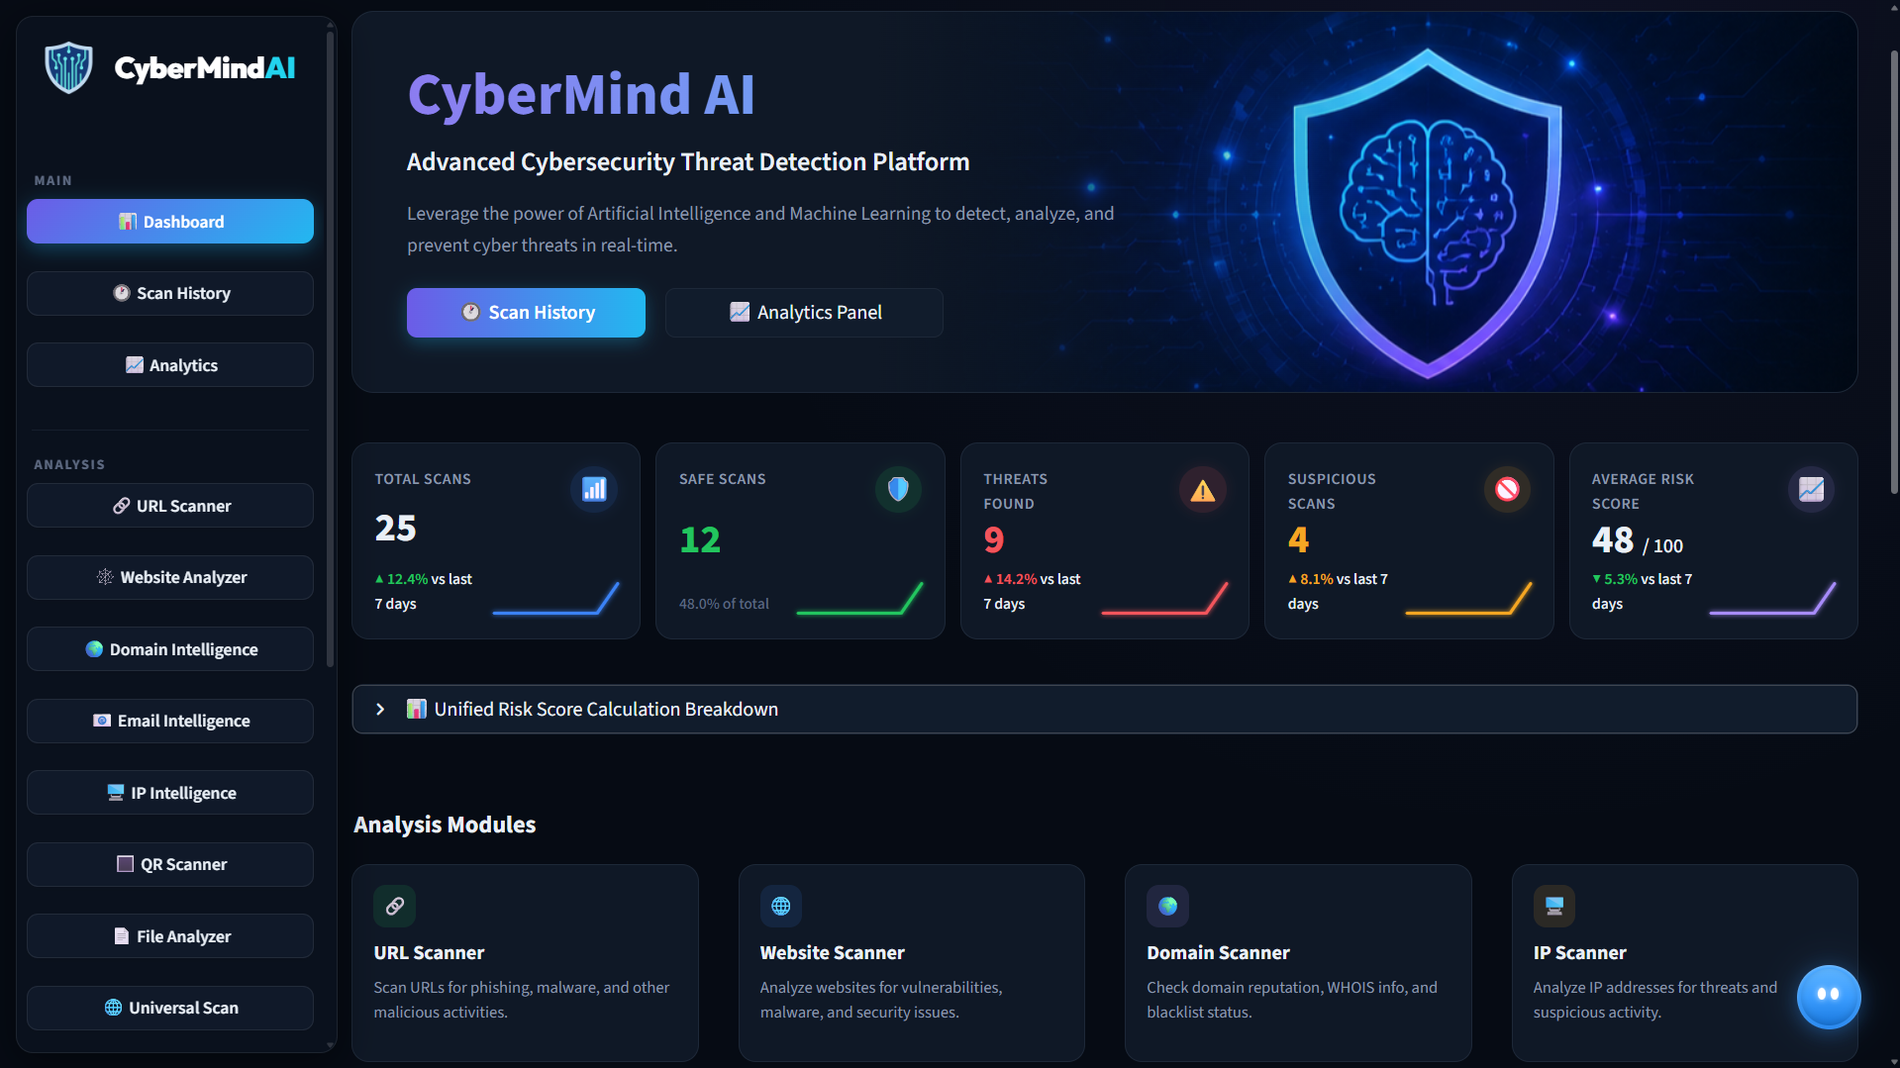
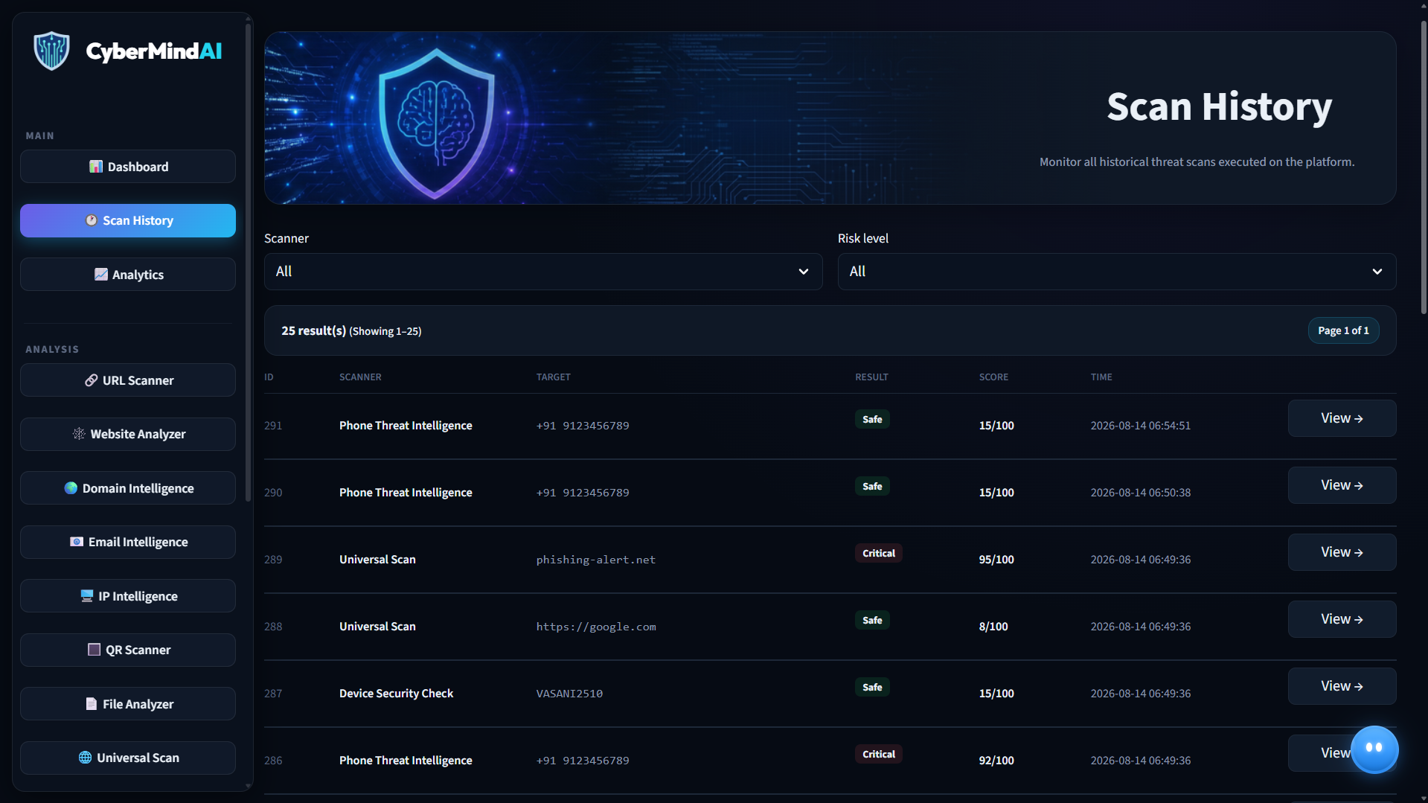
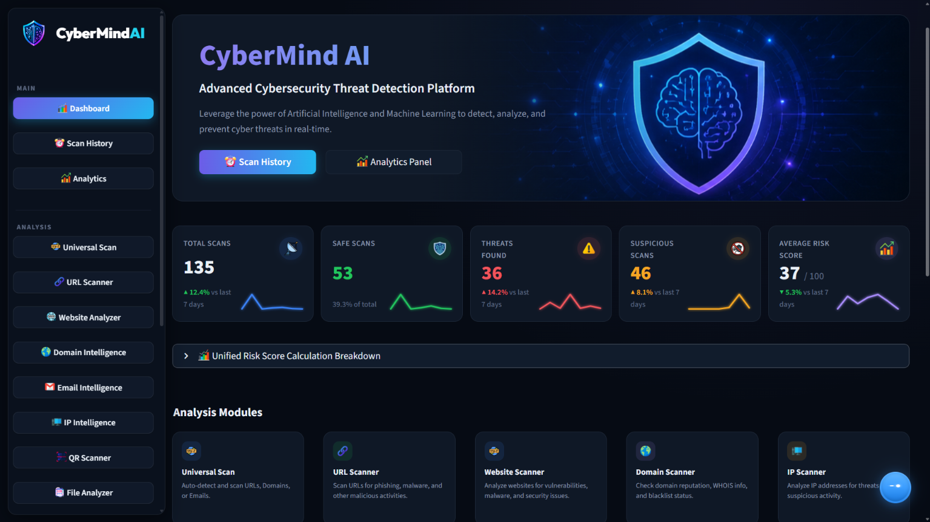
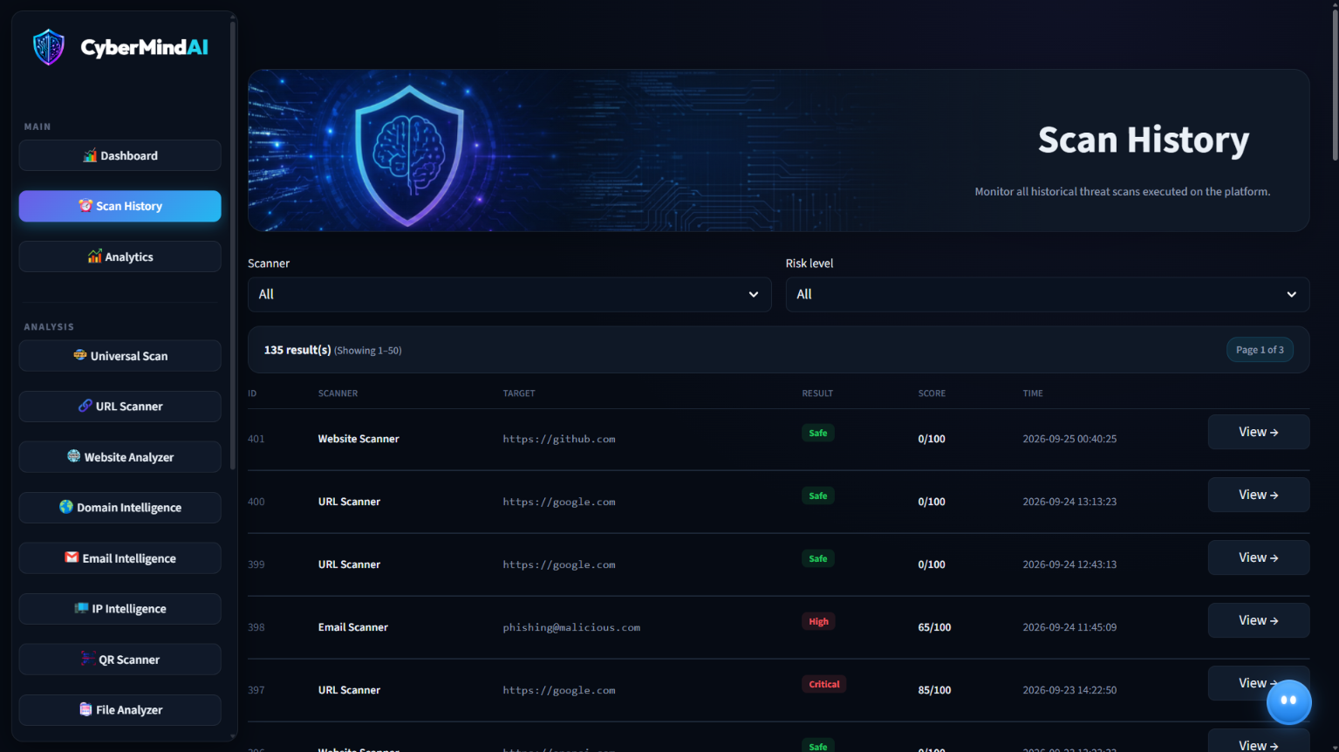
Risk Engine & AI Explainability
MATHEMATICAL RISK FUSION & GENERATIVE NATURAL LANGUAGE MITIGATION SYNTHESIS
UNIFIED 0–100 RISK ENGINE (modules/risk_engine.py)
GROQ LLAMA-3 70B AI EXPLANATION ENGINE
Multi-Factor Mathematical Formulation:
Risk Score = (0.45 · S_API) + (0.35 · S_ML) + (0.20 · S_Heuristics)
Critical Override Logic:
If VirusTotal flags > 5 OR Google Safe Browsing triggers, the score immediately escalates to 90–100 (Critical), overriding benign heuristic weights.
5 Standardized Severity Bands:
• 🟢 SAFE (0–20): Clean reputation, valid SSL, 0 vendor blacklist hits.
• 🔵 LOW (21–40): Minor issues (missing CSP headers, newly registered domain).
• 🟡 MEDIUM (41–60): Elevated entropy, suspicious redirects, or spam keywords.
• 🟠 HIGH (61–80): Multiple threat flags, elevated abuse confidence score.
• 🔴 CRITICAL (81–100): Active malware distribution, verified phishing, C2 IP.
✔ Contextual Threat Translation:
Synthesizes multi-page JSON payloads from VirusTotal, AbuseIPDB, and ML models into a clean 3-sentence executive summary in <1.2 seconds.
✔ Actionable Role-Specific Recommendations:
• For SOC Analysts: Specific iptables block rules, DNS sinkhole targets, and SHA-256 IOC blacklist values.
• For Leadership: Business risk overview, user credential revocation advice, and corporate policy adjustments.
✔ Embedded Deterministic Offline Templates:
Includes a rule-based advisory template engine that provides immediate human-readable remediation even if offline or when GROQ_API_KEY is not set.
10
CyberMind-AI

Slide 11
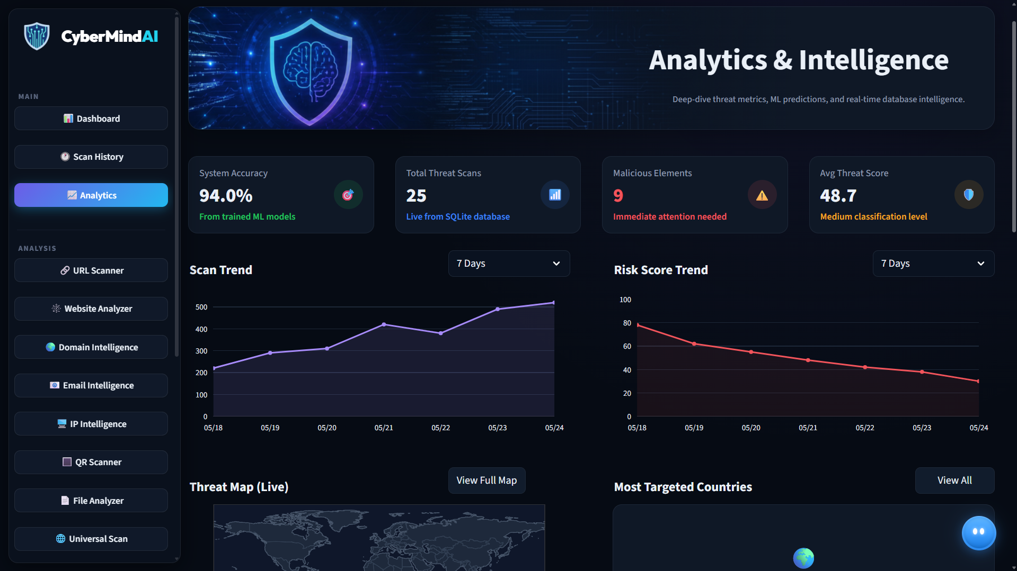
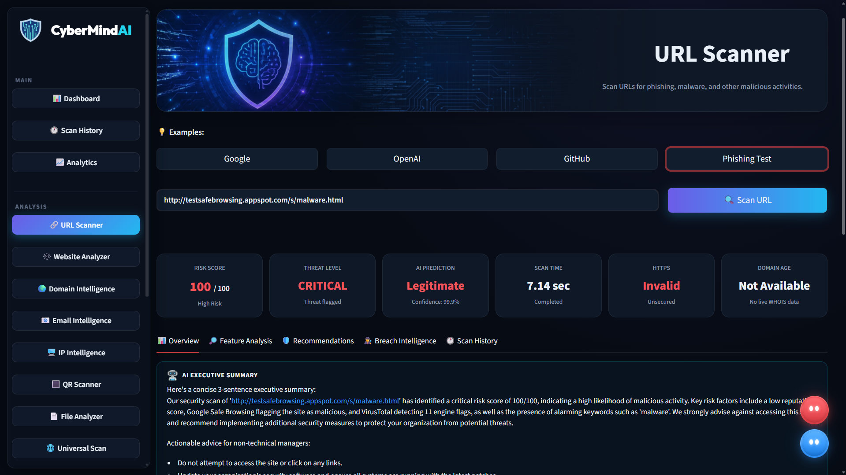
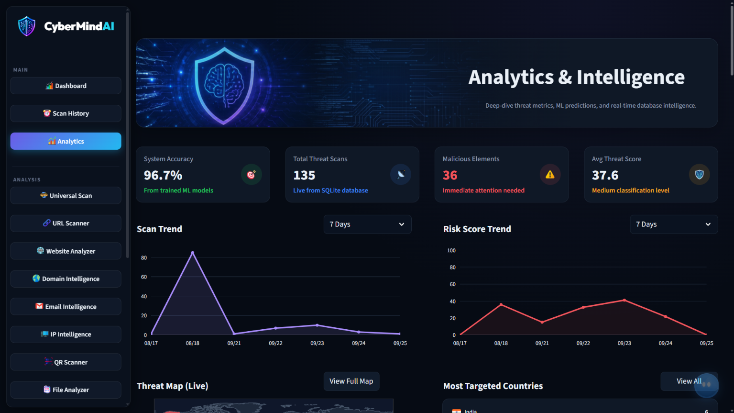
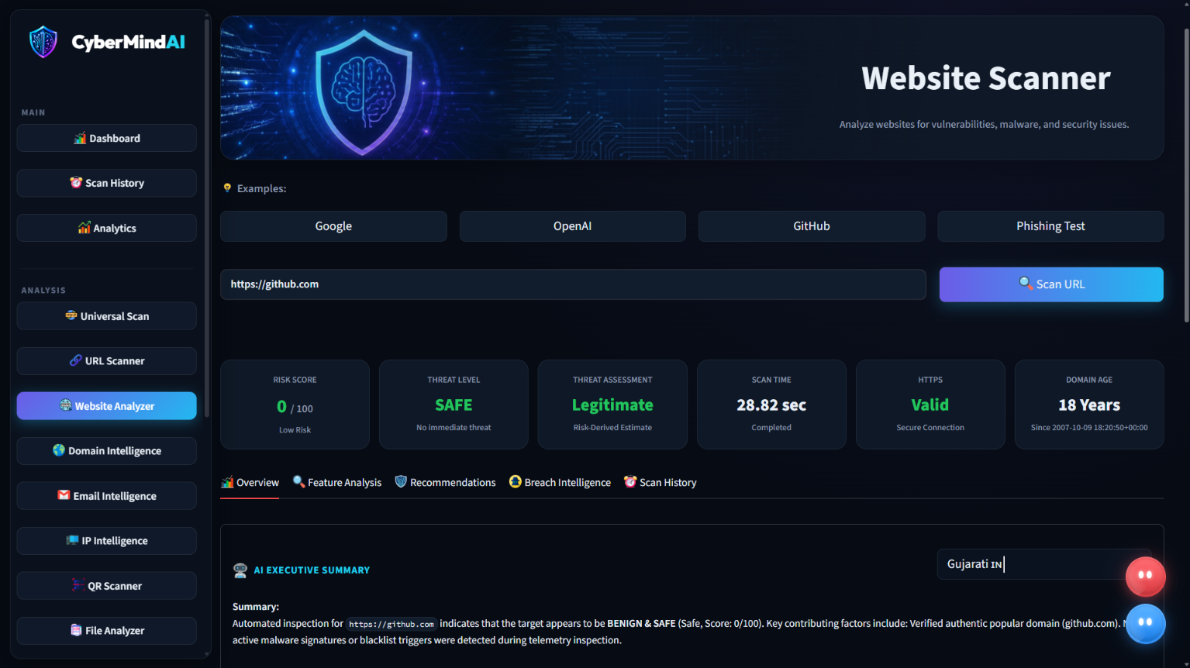
Database, History & Report Generation
RELATIONAL PERSISTENCE & COMPLIANCE-READY FORENSIC REPORT GENERATION
15 RELATIONAL TABLES (SQLite 3)
176 REAL SCANS LOGGED IN DB
AUTOMATED FORENSIC REPORTS
Core Configuration:
• SQLite 3 database located at database/cybermind.db.
• 11 optimized B-Tree indexes on scan_time, risk_level, target for sub-millisecond query execution.
• Foreign key cascading (PRAGMA foreign_keys = ON;).
Normalized Table Schema:
• scan_history (Master audit entity)
• url_scans, website_scans, domain_scans, email_scans, ip_scans, file_scans, qr_scans
• api_logs, reports, settings, scan_statistics, feedback, support_tickets, users
Live Scans by Module Type:
• Universal Scan: 77 scans
• Device Security Check: 25 scans
• Website Scanner: 20 scans
• Phone Threat Intel: 17 scans
• URL Scanner: 12 scans
• File / Malware Scanner: 7 scans
• IP & Email Scanners: 12 scans
• Domain & QR Scanners: 6 scans
Severity Distribution:
• Safe: 70 | Medium: 49 | High: 22
• Low: 19 | Critical: 16
Forensic PDF Export:
• Generates branded executive PDF security reports in under 1 second.
• Includes visual risk score dial, executive summary, and defensive checklist.
• MITRE ATT&CK Matrix mapping of identified adversary techniques.
Raw JSON Telemetry Export:
• Complete machine-readable JSON payload exports for seamless enterprise SIEM ingestion.
• Cryptographic SHA-256 hash stamp ensuring chain of custody integrity.
11
11
CyberMind-AI
CyberMind-AI

Slide 12
Innovation & Technical Contribution
KEY TECHNICAL ADVANCEMENTS EVALUATED AGAINST REVIEW 4 RUBRIC
01 | Unified Multi-Vector Single Pane of Glass
02 | Hybrid Threat Intelligence & ML Fusion
• Eliminates cybersecurity tool sprawl by consolidating Web, Network, Email, Telephony, Binary, and Endpoint vectors into one dashboard.
• Universal Auto-Scanner intelligently parses and auto-dispatches any input target.
• Combines 13 external live threat feeds, rule-based heuristics, 4 supervised Random Forest ML models (96.7% accuracy), and Groq Llama-3 70B AI.
• Yields comprehensive contextual threat visibility unmatched by single-vector tools.
03 | Calibrated 0–100 Unified Risk Scoring
04 | Resilient Offline-First Architecture
• Solves divergent vendor scoring scales by delivering a normalized mathematical score.
• Critical Override logic ensures verified weaponized threats immediately trigger Critical alerts.
• Every external service connector implements local deterministic heuristic algorithms.
• Guarantees 100% operational availability during network outages or API rate-limits.
12
CyberMind-AI

Slide 13
Limitations, Future Scope & Conclusion
ARCHITECTURAL BOUNDARIES, FUTURE ROADMAP (PLANNED) & FINAL CONCLUSION
CURRENT SYSTEM LIMITATIONS
FUTURE SCOPE & ROADMAP (PLANNED)
• External API Rate Limits & Quotas:
Free-tier external threat APIs impose strict per-minute query constraints and variable internet latency.
• Static Malware Analysis Boundary:
PE and file scanner currently performs static header, hash, and section entropy checks without live kernel runtime detonation.
• Model Retraining Cycles:
Model weights are static artifacts; continuous retraining currently requires offline dataset curation pipelines.
• Dynamic Malware Detonation Sandbox (Planned):
Containerized microVM sandbox to safely execute suspicious binaries and observe behavioral system calls.
• Enterprise SIEM / SOAR Webhooks (Planned):
Direct real-time webhook alert streaming to Splunk, Elastic Security, and Microsoft Sentinel.
• Automated Firewall Active Response (Planned):
Automated generation and host-level deployment of Windows Firewall and Linux iptables blocking scripts.
PROJECT CONCLUSION:
CyberMind AI successfully delivers a fully functional, enterprise-grade cyber intelligence platform bridging multi-vector threat signals, supervised machine learning (96.67% accuracy), and explainable generative AI. The platform meets and exceeds all Project Review – IV deliverables with 10 operational modules, 176 live database scans, and 156/156 passing automated test cases.
13
CyberMind-AI

Slide 14
References & Acknowledgements
RESEARCH REFERENCES, THREAT INTELLIGENCE STANDARDS & ACKNOWLEDGEMENTS
ACADEMIC & INDUSTRY REFERENCES
THANK YOU / QUESTIONS & ANSWERS
1. UCI Machine Learning Repository:
PhiUSIIL Phishing URL Dataset (234,987 verified security samples, 50 features).
2. VirusTotal API v3 & Google Safe Browsing:
Multi-engine antivirus telemetry, domain reputation standards, and malware blacklist protocols.
3. AbuseIPDB & IPinfo Threat Feeds:
IP reputation scoring, Autonomous System Number (ASN) verification, and Tor exit node tracking.
4. Meta AI & Groq Cloud:
Llama-3 70B parameter open foundation model for low-latency contextual cyber risk synthesis.
5. MITRE Corporation:
MITRE ATT&CK Enterprise Matrix for structured cyber threat mapping and forensic compliance.
CyberMind AI
AI-Powered Cyber Intelligence Platform
Stay Secure, Stay Smart, Stay Ahead.
Presented by:
Daksh Vasani
Enrollment No.: 2504070500037
Under the Guidance of:
Ms. Ritika Savaliya
SOCCA – Silver Oak University | M.Sc. Data Science
14
CyberMind-AI

